Slide 1

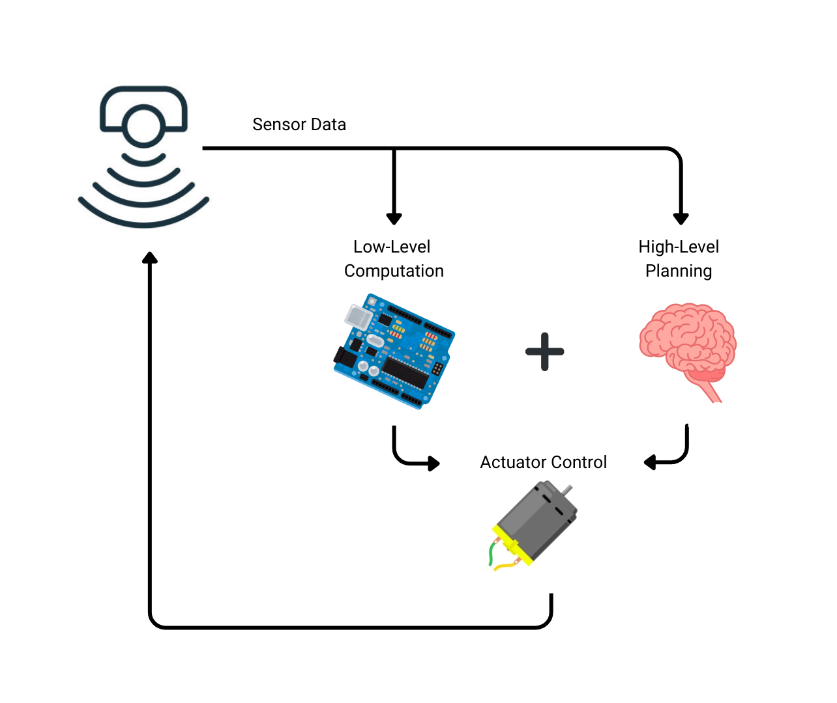
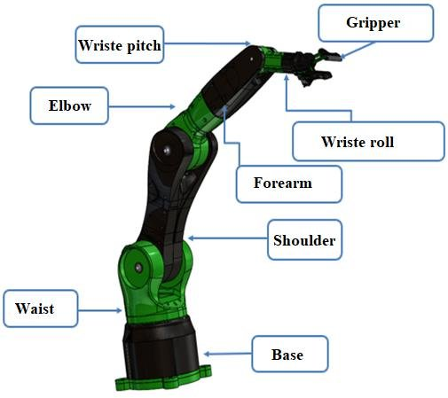
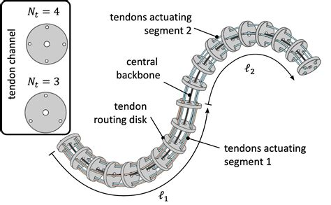
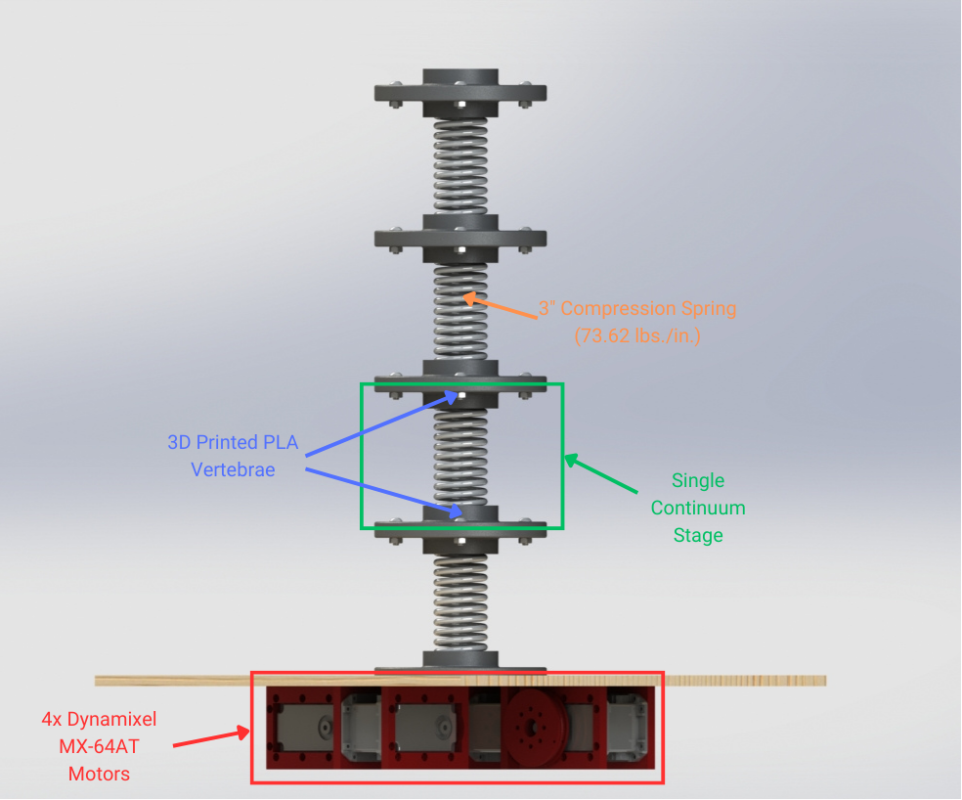
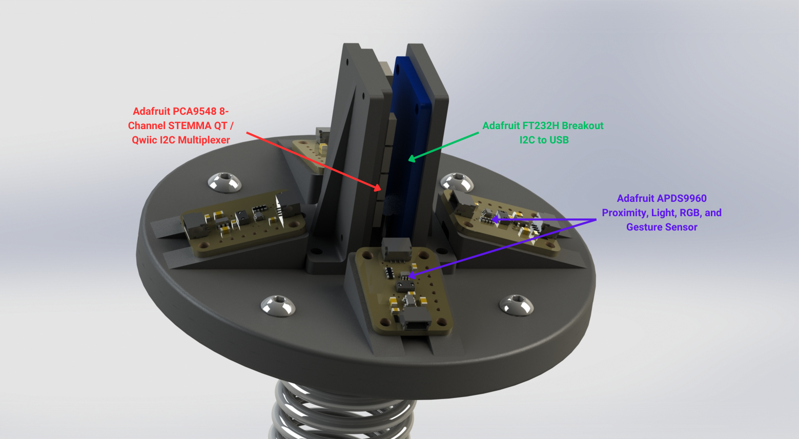


Reflex-Based Control of Multi-Staged Tendon-Driven Continuum Robots
William Weiss, Yu Gu, and Trevor Smith
West Virginia University, Department of Mechanical, Materials and Aerospace Engineering
1. Background
2. Objectives
Research into continuum robots first appeared in the 1960s with Anderson and Horn’s Tensor Arm (citation needed).
Compared to ridged-link robots, continuum robots can conform and bend around obstacles.
In general, designs feature a compliant backbone – could be compressible or uncompressible.
One approach to actuation is to use tendons, that when pulled, cause a bending motion.
Has applications in fields such as surgery, remote maintenance, and process automation.
The primary motivation behind this study is to demonstrate how reflexes, defined as involuntary and rapid responses to external stimuli, can be integrated into continuum robots to create a more “life-like” control architecture. To achieve this, we designed and constructed a continuously deformable tendon-driven robot.
Fig. 1. Labeled diagram of 6 DOF robotic arm
Fig. 2. General structure of a tendon-driven continuum robot
Fig. 3. How reflexes can be combined with high-level planning to achieve a more robust and organic control architecture
3. Methods
In order to demonstrate reflex-based control, a tendon-driven muti-staged continuum robot was commissioned. The robot is actuated via four Dynamixel servo motors concealed beneath the base. These motors drive four complementary fishing line tendons wound about spools. When a motor is driven,
a tension force is felt by the tendon
resulting in a bending moment
about the termination point.
Compliance and elastic recovery of
the backbone is provided by coaxially
located compression-springs.
These springs are fixtured to ridged
vertebra which can be stacked as
discrete stages.
Reflex responses are trigger by four Adafruit APDS9960 light sensors with one sensor facing in each cardinal direction. By measuring the difference in luminosity between opposite sensors, the direction of a light source can be determined. A proportional velocity command then moves the arm end effector towards the light source.
Fig. 4. Labeled diagram of continuum arm design
4. Results and Future Work
Fig. 5. Light sensing payload
Project is still very much in progress, but we predict that the development of reflex in robotics control could have broad implications for various fields, including medical robotics, remote maintenance, and industrial automation, ultimately contributing to the development of more efficient and capable robotic systems.
Decentralized nature of reflex enables a more robust control architecture
Could improve response times and the robot’s ability to adapt
Poses a new a interesting control architecture that opposes conventual centralized control
Future work will likely involve the implementation of additional and more complex reflex arches. For example, reflexes may be triggered by torque monitoring, luminosity data, or IMU feedback. Additional focus should also be placed on the qualitative advantages of reflex over traditional centralized control. Research could also focus on biological parallels and demonstrations (e.g. plant and root growth)
wpw00001@mix.wvu.edu
Notes:
Example slide with title and text in two column format - Gold background with topo texture.

